Slide 1



University of Limassol – Cyprus
Msc Shipping Operations & Management

Slide 2

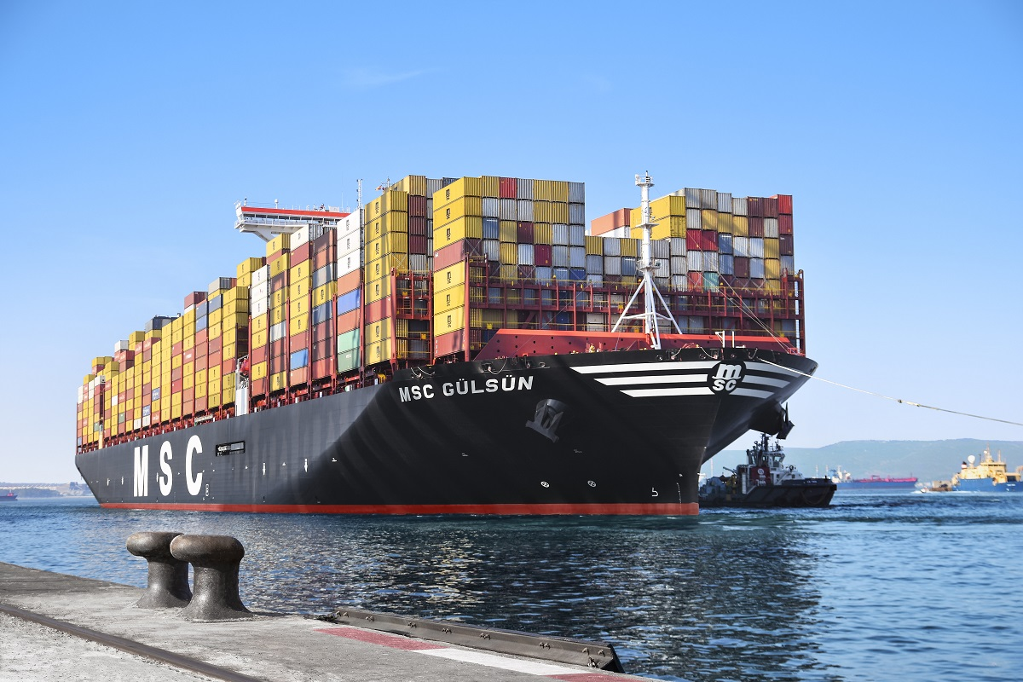
Introduction:-
The University of Limassol was established in 1990 by a group of business leaders and a team of prominent academics representing some of the world’s top business schools. Our aim has been to draw on the best teachers in graduate management education irrespective of location and make their talent and experience available in Cyprus.
The MSc in Shipping Operations & Management is unique, innovative, and global by design, world-class in quality and affordable in cost. The program is unique in the region and possibly globally in being designed to cater to the needs of participants and employers through purely shipping-related courses.

Slide 3

Facts & Figures -
MSc in Shipping Operations & Managment
Duration:- 15 months
Fees:- €8,000
Start date:- March and Sept Twice every Year
Mode of conduct:- Online
Number of nationalities:- Worldwide

Slide 4
Course Details:-
Maritime and shipping economics by analysing the demand and supply in international trade and shipping, ship economics, and the economics of specialized shipping markets.
Human resource practices in crew management and in particular leadership and team building, training, retention, safety and quality standards and performance management of the seafarers.
Ship Operations performance and optimization through models & techniques for effective ship operations management and data analytics for improving shipping operation efficiencies
Charter markets, chartering practice and charter party analysis in dry cargo and tanker shipping, and how to analyse the terms & conditions, responsibilities & accountabilities in charter party contracts.
protection

Slide 5
Curriculum
The legal issues arising from the transportation of goods by sea, and the principles governing contracts of the carriage of goods by sea and maritime insurance.
Port economics and logistics pertaining to the port development, operation, efficiency and governance, as well as logistics and the integration of ports and terminals in global supply chains.
Financing of shipping operations and the management of risk in the shipping industry, including the financial performance of shipping firms and shipping-risk management tools, such as shipping derivatives
Environmental protection and safety in the shipping industry and in particular, how management uses key performance indicators to monitor safety and environmental

Slide 6
Why this Course/Benefits of the course:-
The MSc in Shipping Operations & Management aims to equip students and shipping professionals with the knowledge, management skills and competencies required to pursue or enhance a successful career in shipping operations, and maritime management including maritime logistics.
The objectives of the course include:
To develop comprehensive knowledge in shipping using interdisciplinary insights.
To provide a global understanding of shipping and the maritime industry and to enable participants to apply the advanced knowledge gained to shipping operations and ship management
To develop the expertise and professional outlook required to foster a successful career in international shipping and maritime logistics.

Slide 7
Placements/Career Prospects:-
The graduates of the program have great potential for local and international careers in international shipping and maritime logistics.
It is envisaged that a significant part of the students enrolled in the program will be already employed in the maritime industry and will be seeking to enhance their career prospects, skills and knowledge by enrolling on the on-line degree.
Cyprus-based participants will have the opportunity for employment locally in the numerous shipping and ship management companies as Cyprus is regarded among the top three global ship management centres. Employability prospects are great as hundreds of skilled and educated graduates are employed locally every year, the ship management companies rightly regarded as among the best employers on the island.
Greece-based participants will have the opportunity to be employed in the number one ship-owning nation of the world in addition to the option of pursuing an international career.

Slide 8
Application Requirements
Eligibility requirements:
To graduate, students are required to successfully complete the programme’s 9 core modules, (10 ECTS credits each), for a total of 90 ECTS credits
How To Apply – You can connect with us at education@seaandbeyond.com or +91 89761 24339

Slide 9

Value Added Services Offered by Sea And Beyond
Education Counselling -
We assist mariners in terms of course & program selection, University Selection and what will be the best possible way to navigate your career.
Visa Assistance -
Immigration to the UK, Australia, Canada and EU. we will help you in getting your student Visa.
Financial Assistance -
We will help you in getting Financial assistance from Banks NBFC With the best interest rates in the market.
Forex Remittance-
We help you in remitting fees to Universities making this process hassle-free.

Slide 10

Thank You!!!

